Slide 1


CSCE 5610
Computer System Architecture
Instruction Level Parallelism

Slide 2
Pipeline hazards
Hazards: Situations in pipelined Datapath, in which the next instruction cannot execute in the following clock cycle.
Three types of hazards:
Structural Hazards
Data Hazards
Control Hazards

Slide 3
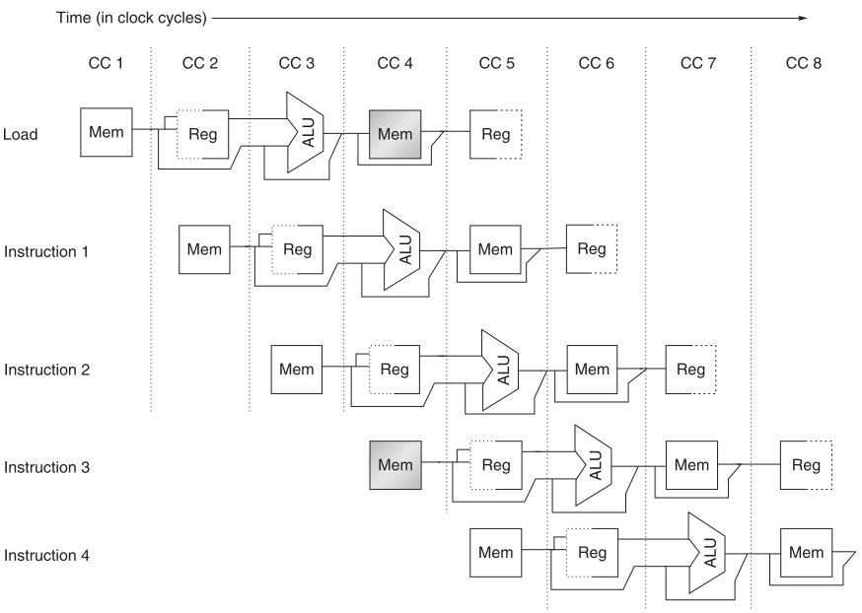

Structural Hazards
Structural Hazards: The hardware cannot support the combination of instructions that are required to be executed in the same clock cycle
MIPS instruction set is designed to be pipelined making it easy to avoid structural hazards.
Suppose we had a single memory instead of two data and instruction
memories

Slide 4
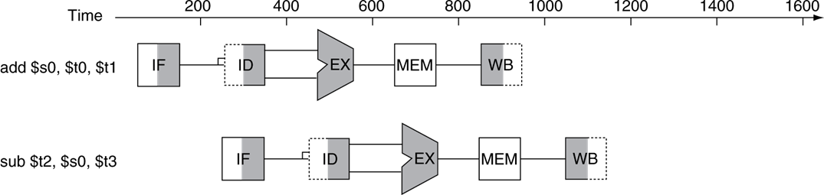
Data Hazards
Data Hazards occur when an instruction depends on the results of a previous instruction in a way that is exposed by the overlapping of instructions in the pipeline.
Example 1:
add $s0, $t0, $t1
sub $t2, $s0, $t3
The add instruction does not write it results until the fifth step.
The result of add instruction $s0 is required in this step.

Slide 5
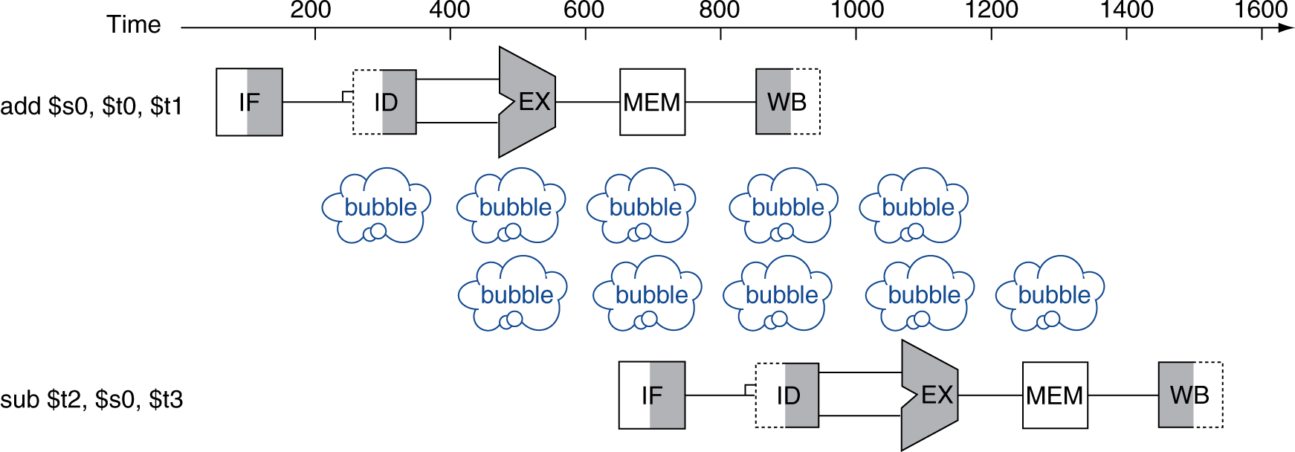
Data Hazards
Example 1:
add $s0, $t1, $t2
sub $t2, $s0, $t3
Stalling: a simple but slow solution

Slide 6
Pipeline Performance with stalls
Assume the stages are balanced, speedup of pipelining?

Slide 7

Pipeline Performance with stalls
If there are no stalls, the speedup is equal to the number of pipeline stages. However, if we add two stalls after each instruction in a 5-stage pipelined MIPS processor:
$$Maximum Speedup from pipelining= \frac{1}{3}×5=1.67$$

Slide 8
Data hazards – Dependency Arrow
Clock cycle
 |  | 1 | 2 | 3 | 4 | 5 | 6 | 7 | 8 | 9
sub | $2, $1, $3 | IF | ID | EX | MEM | WB
and | $12, $2, $5 |  | IF | ID | EX | MEM | WB
or | $13, $6, $2 |  |  | IF | ID | EX | MEM | WB
add | $14, $2, $2 |  |  |  | IF | ID | EX | MEM | WB
sw | $15, 100($2) |  |  |  |  | IF | ID | EX | MEM | WB
Arrows indicate the flow of data between instructions.
The tails of the arrows show when register $2 is written.
The heads of the arrows show when $2 is read.
Any arrow that points backwards in time represents a data hazard in our basic pipelined datapath. Here, hazards exist between instructions 1 & 2 and 1 & 3.

Slide 9
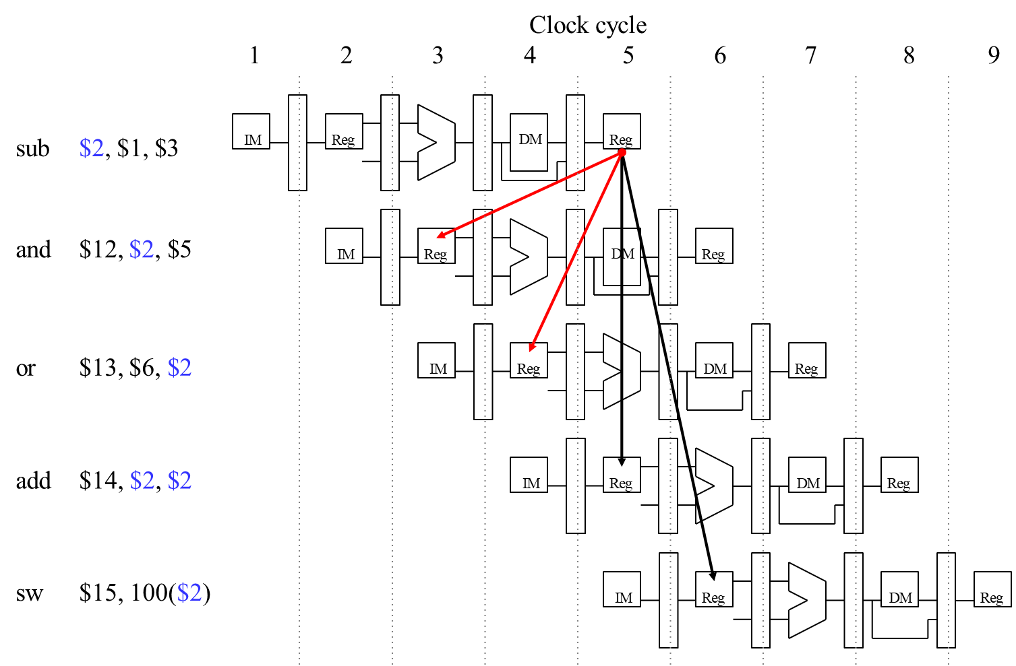
A Fancier Pipeline Diagram

Slide 10
A more Detailed Look at the Pipeline
We have to eliminate the hazards, so the AND and OR instructions in our example will use the correct value for register $2.
When is the data is actually produced and consumed?
What can we do?
Clock cycle
 | 1 | 2 | 3 | 4 | 5 | 6 | 7
sub $2, $1, $3 | IF | ID | EX | MEM | WB
and $12, $2, $5 |  | IF | ID | EX | MEM | WB
or $13, $6, $2 |  |  | IF | ID | EX | MEM | WB

Slide 11
A more Detailed Look at the Pipeline
We have to eliminate the hazards, so the AND and OR instructions in our example will use the correct value for register $2.
Let’s look at when the data is actually produced and consumed.
The SUB instruction produces its result in its EX stage, during cycle 3 in the diagram below.
The AND and OR need the new value of $2 in their EX stages, during clock cycles 4-5 here.
Clock cycle
 | 1 | 2 | 3 | 4 | 5 | 6 | 7
sub $2, $1, $3 | IF | ID | EX | MEM | WB
and $12, $2, $5 |  | IF | ID | EX | MEM | WB
or $13, $6, $2 |  |  | IF | ID | EX | MEM | WB

Slide 12
A more Detailed Look at the Pipeline
The actual result $1 - $3 is computed in clock cycle 3, before it’s needed in cycles 4 and 5.
If we could somehow bypass the writeback and register read stages when
needed, then we can eliminate these data hazards.
Now, we’ll focus on hazards involving arithmetic instructions.
Next time, we’ll examine the lw instruction.
Essentially, we need to pass the ALU output from SUB directly to the AND
and OR instructions, without going through the register file.
Clock cycle
 | 1 | 2 | 3 | 4 | 5 | 6 | 7
sub $2, $1, $3 | IF | ID | EX | MEM | WB
and $12, $2, $5 |  | IF | ID | EX | MEM | WB
or $13, $6, $2 |  |  | IF | ID | EX | MEM | WB

Slide 13
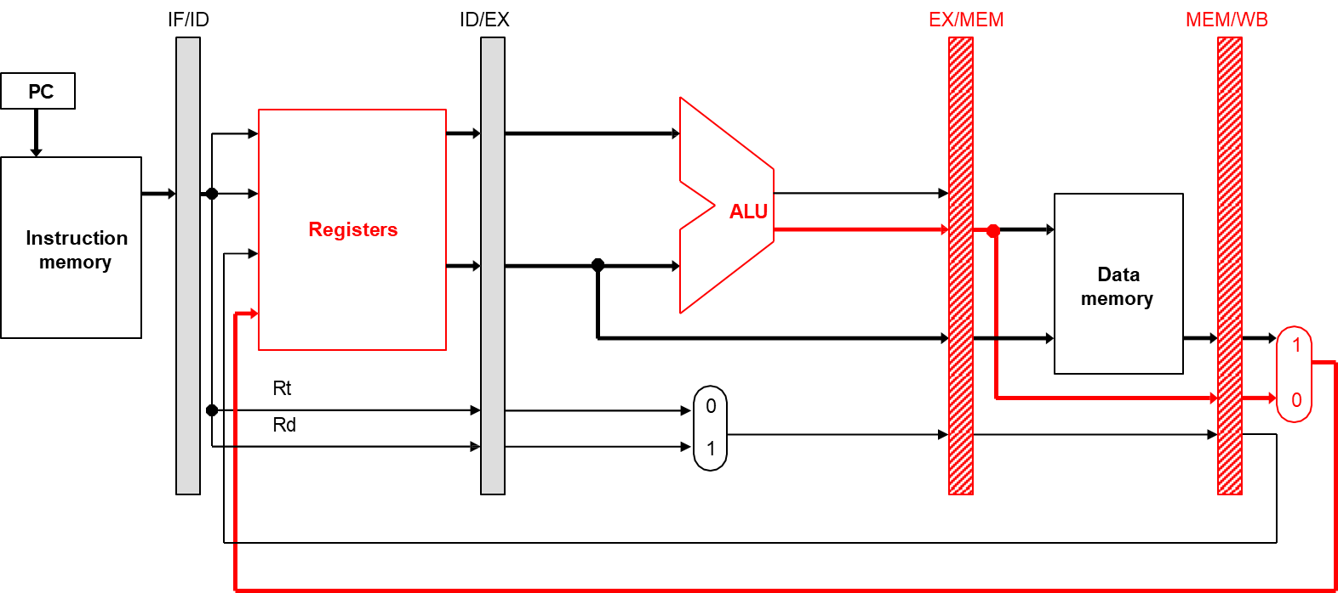
Where to find the ALU result
The ALU result generated in the EX stage is normally passed through the pipeline registers to the MEM and WB stages, before it is finally written to the register file.
This is an abridged diagram of our pipelined datapath.

Slide 14
Forwarding/Bypassing
Since the pipeline registers already contain the ALU result, we could just forward that value to subsequent instructions, to prevent data hazards.
In clock cycle 4, the AND instruction can get the value $1 - $3 from
the EX/MEM pipeline register used by sub.
Then in cycle 5, the OR can get that same result from the MEM/WB pipeline register being used by SUB.
Clock cycle
1 2 3 4 5 6 7
IM
Reg
DM
Reg
sub $2, $1, $3
and $12, $2, $5
IM
Reg
DM
Reg
or $13, $6, $2
IM
Reg
DM
Reg

Slide 15
Outline of Forwarding Hardware
A forwarding unit selects the correct ALU inputs for the EX stage.
If there is no hazard, the ALU’s operands will come from the register file, just like before.
If there is a hazard, the operands will come from either the EX/MEM
or MEM/WB pipeline registers instead.
The ALU sources will be selected by two new multiplexers, with control signals named ForwardA and ForwardB.
IM
Reg
DM
Reg
sub $2, $1, $3
and $12, $2, $5
IM
Reg
DM
Reg
or $13, $6, $2
IM
Reg
DM
Reg

Slide 16
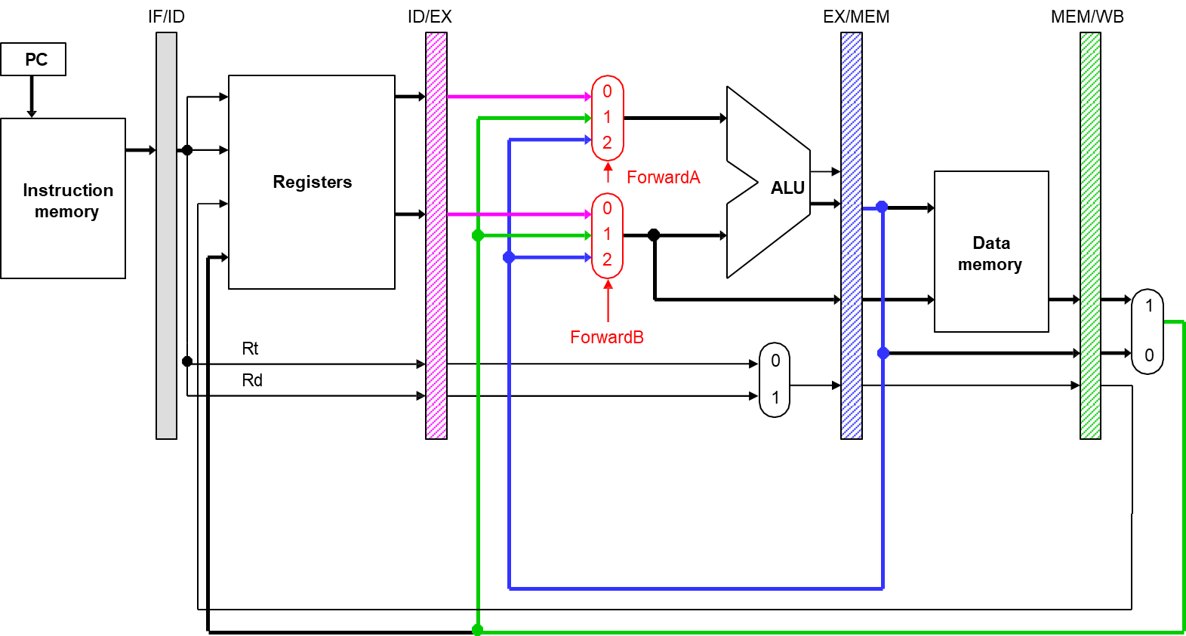
Simplified Datapath with Forwarding Muxes

Slide 17
Detecting EX/MEM data hazards
So how can the hardware determine if a hazard exists?
IM
Reg
DM
Reg
sub $2, $1, $3
and $12, $2, $5
IM
Reg
DM
Reg

Slide 18
Detecting EX/MEM data hazards
So how can the hardware determine if a hazard exists?
An EX/MEM hazard occurs between the instruction currently in its EX
stage and the previous instruction if:
The previous instruction will write to the register file, and
The destination is one of the ALU source registers in the EX stage.
There is an EX/MEM hazard between the two instructions below.
IM
Reg
DM
Reg
sub $2, $1, $3
and $12, $2, $5
IM
Reg
DM
Reg
Data in a pipeline register can be referenced using a class-like syntax. For example, ID/EX.RegisterRt refers to the rt field stored in the ID/EX pipeline.

Slide 19
EX/MEM data hazard equations
The first ALU source comes from the pipeline register when necessary.
if (EX/MEM.RegWrite = 1
and EX/MEM.RegisterRd = ID/EX.RegisterRs)
then ForwardA = 2
The second ALU source is similar.
if (EX/MEM.RegWrite = 1
and EX/MEM.RegisterRd = ID/EX.RegisterRt) then ForwardB = 2
IM
Reg
DM
Reg
sub $2, $1, $3
and $12, $2, $5
IM
Reg
DM
Reg
Notes:
Regwrite = 1 we update.

Slide 20
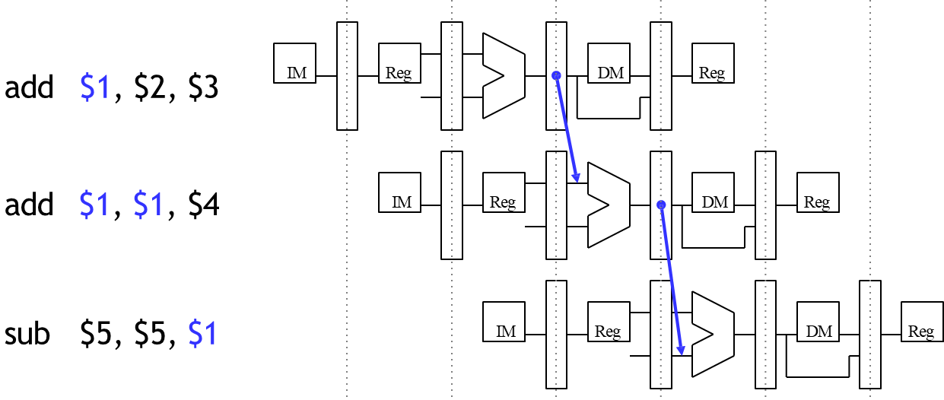
Detecting MEM/WB data hazards
A MEM/WB hazard may occur between an instruction in the EX stage and the instruction from two cycles ago.
One new problem is if a register is updated twice in a row.
add | $1, | $2, | $3
add | $1, | $1, | $4
sub | $5, | $5, | $1
Register $1 is written by both of the previous instructions, but only the most recent result (from the second ADD) should be forwarded.

Slide 21
MEM/WB hazard equations
Here is an equation for detecting and handling MEM/WB hazards for the first ALU source.
if (MEM/WB.RegWrite = 1
and MEM/WB.RegisterRd = ID/EX.RegisterRs
and (EX/MEM.RegisterRd ≠ ID/EX.RegisterRs or EX/MEM.RegWrite = 0) then ForwardA = 1
The second ALU operand is handled similarly.
if (MEM/WB.RegWrite = 1
and MEM/WB.RegisterRd = ID/EX.RegisterRt
and (EX/MEM.RegisterRd ≠ ID/EX.RegisterRt or EX/MEM.RegWrite = 0) then ForwardB = 1

Slide 22
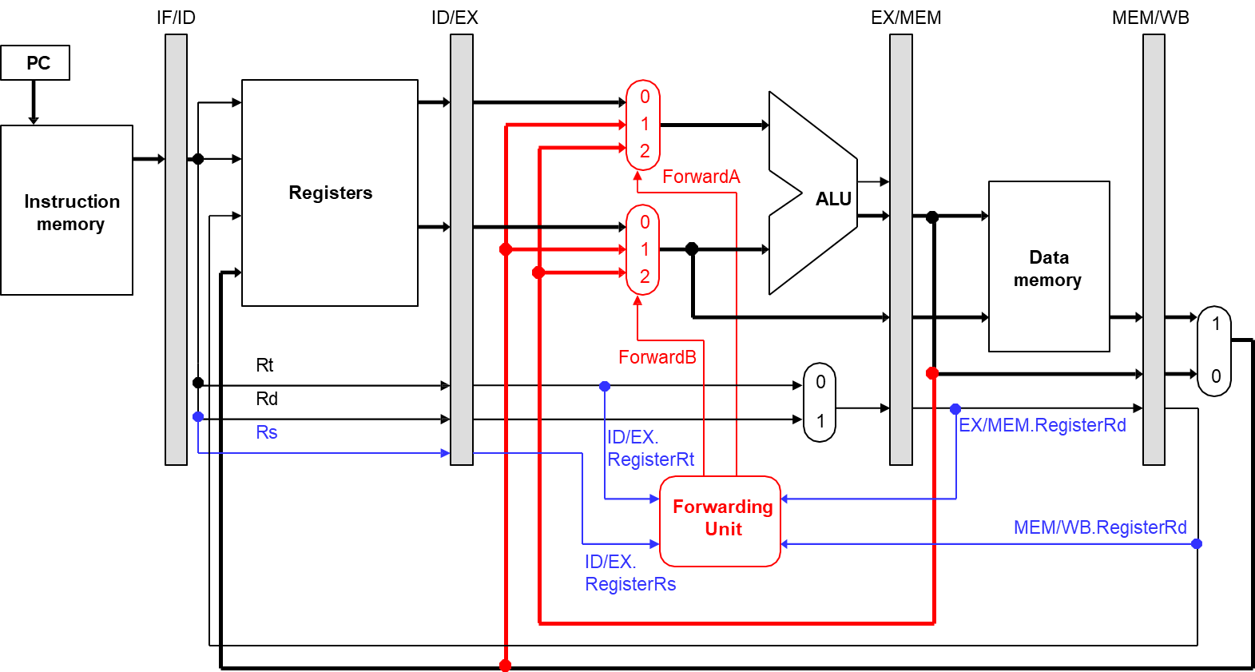
Simplified Datapath with Forwarding

Slide 23
The Forwarding Unit
The forwarding unit has several control signals as inputs.
ID/EX.RegisterRs | EX/MEM.RegisterRd | MEM/WB.RegisterRd
ID/EX.RegisterRt | EX/MEM.RegWrite | MEM/WB.RegWrite
(The two RegWrite signals are not shown in the diagram, but they come from the control unit.)
The fowarding unit outputs are selectors for the ForwardA and ForwardB multiplexers attached to the ALU. These outputs are generated from the inputs using the equations on the previous pages.
Some new buses route data from pipeline registers to the new muxes.

Slide 24
Example
sub $2, $1, $3
and | $12, | $2, | $5
or | $13, | $6, | $2
add | $14, | $2, | $2
sw $15, 100($2)
Assume again each register initially contains its number plus 100.
After the first instruction, $2 should contain -2 (101 - 103).
The other instructions should all use -2 as one of their operands.
We’ll try to keep the example short.
Assume no forwarding is needed except for register $2.
We’ll skip the first two cycles, since they’re the same as before.

Slide 25
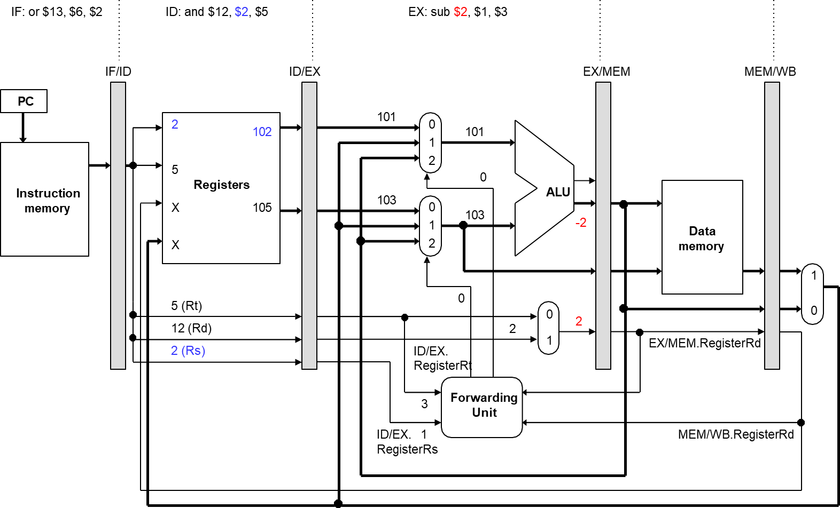
Clock cycle 3

Slide 26
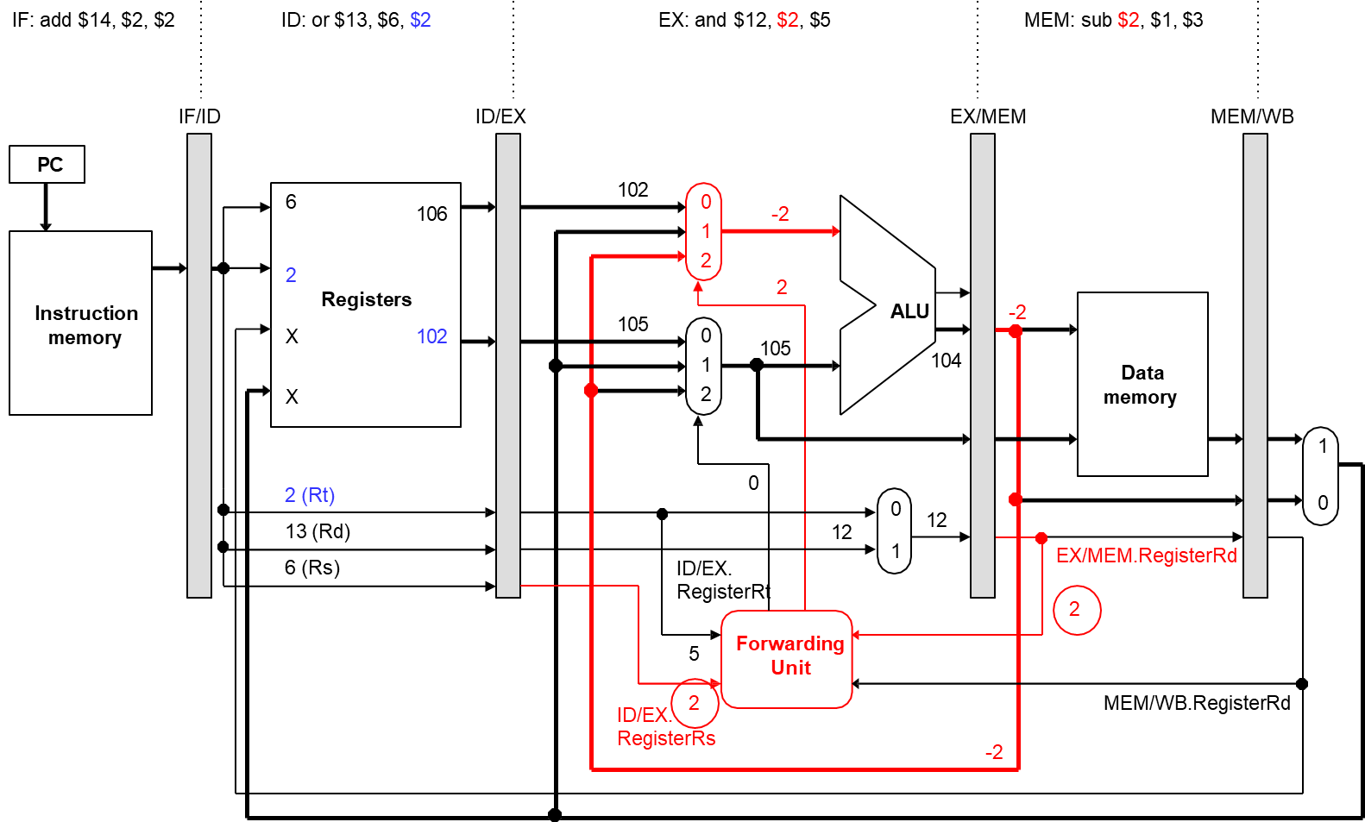
Clock cycle 4: Forwarding $2 from EX/MEM

Slide 27
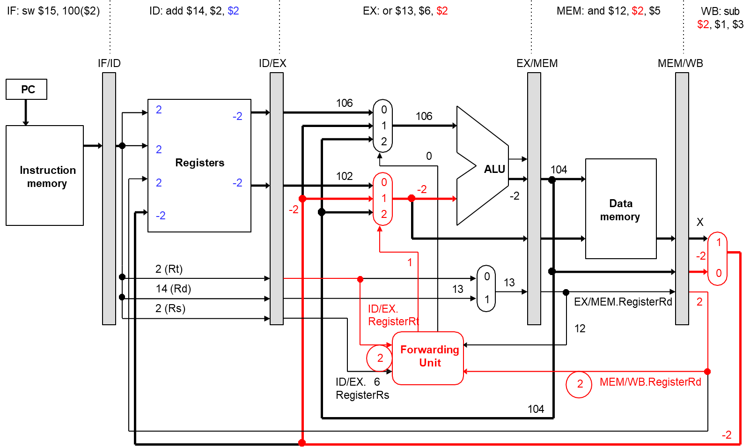
Clock cycle 5: Forwarding $2 from MEM/WB

Slide 28
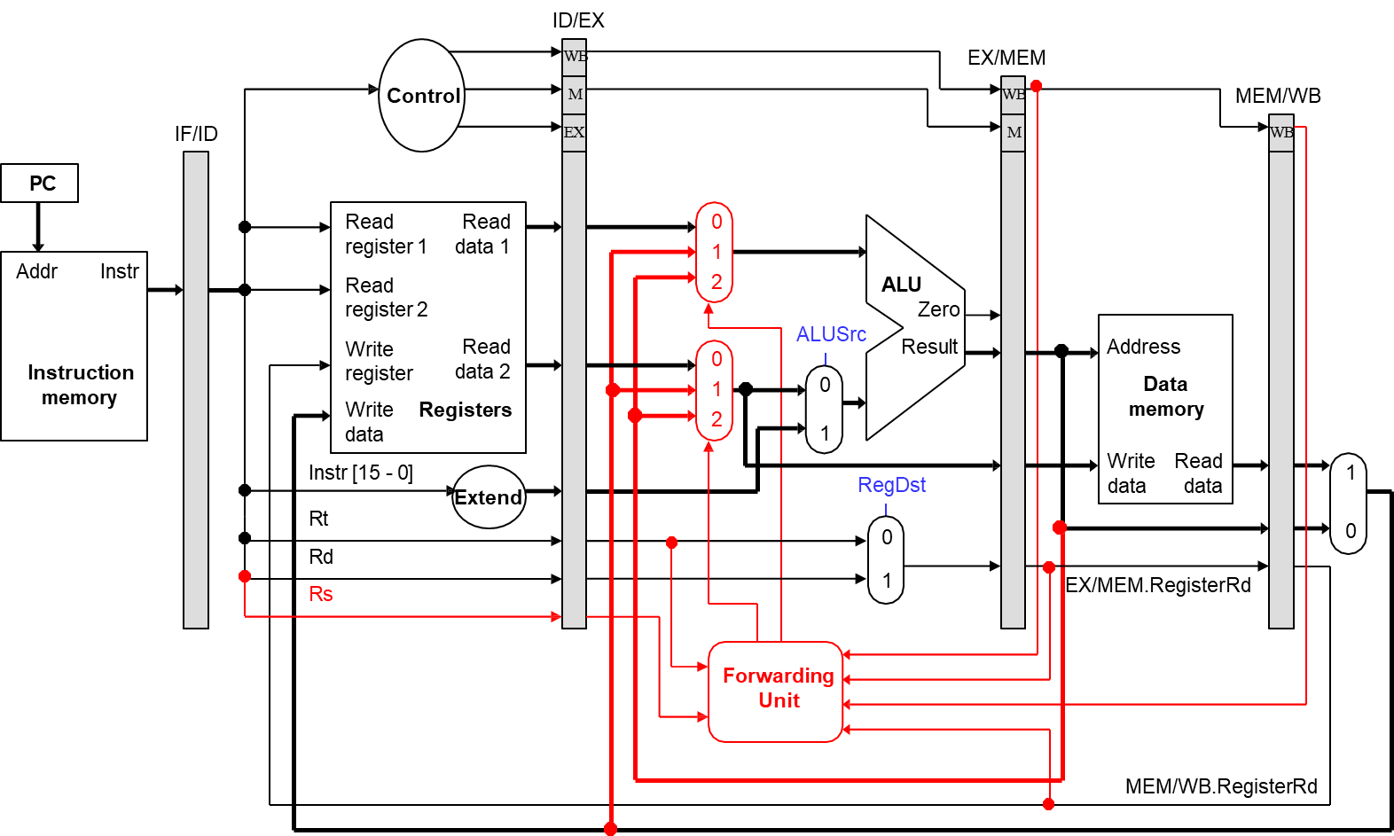
Complete Pipelined Datapath...so far

Slide 29
Stalls and Flushes
So far, we have discussed data hazards that can occur in pipelined CPUs if some instructions depend upon others that are still executing.
Many hazards can be resolved by forwarding data from the pipeline registers, instead of waiting for the writeback stage.
The pipeline continues running at full speed, with one instruction beginning on every clock cycle.
Now, we’ll see some real limitations of pipelining.
Forwarding may not work for data hazards from load instructions.
Branches affect the instruction fetch for the next clock cycle.
In both of these cases we may need to slow down, or stall, the pipeline.

Slide 30
What about loads?
Imagine if the first instruction in the example was LW instead of SUB.
— How does this change the data hazard?
Example 2:
Clock cycle
3 4
1
2
5
6
lw $2, 20($3)
IM
Reg
DM
Reg
and $12, $2, $5
IM
Reg
DM
Reg

Slide 31

Stalling
The easiest solution is to stall the pipeline.
We could delay the AND instruction by introducing a one-cycle delay into
the pipeline, sometimes called a bubble.
Clock cycle
3 4
1
2
5
6
7
lw $2, 20($3)
IM
Reg
DM
Reg
and $12, $2, $5
IM
Reg
DM
Reg
Notice that we’re still using forwarding in cycle 5, to get data from the MEM/WB pipeline register to the ALU.

Slide 32

Stalling and Forwarding
Without forwarding, we’d have to stall for two cycles to wait for the LW instruction’s writeback stage.
Clock cycle
1
2
3
4
5
6
7
8
lw $2, 20($3)
IM
Reg
DM
Reg
and $12, $2, $5
IM
Reg
DM
Reg
In general, you can always stall to avoid hazards—but dependencies are very common in real code, and stalling often can reduce performance by a significant amount.

Slide 33
Stalling Delays the Entire Pipeline
If we delay the second instruction, we’ll have to delay the third one too.
— Why?
Clock cycle
4
1
2
3
5
6
7
8
IM
Reg
DM
Reg
lw $2, 20($3)
and $12, $2, $5
IM
Reg
DM
Reg
or $13, $12, $2
IM
Reg
DM
Reg

Slide 34
Stalling Delays the Entire Pipeline
If we delay the second instruction, we’ll have to delay the third one too.
This is necessary to make forwarding work between AND and OR.
It also prevents problems such as two instructions trying to write to
the same register in the same cycle.
Clock cycle
4
1
2
3
5
6
7
8
IM
Reg
DM
Reg
lw $2, 20($3)
and $12, $2, $5
IM
Reg
DM
Reg
or $13, $12, $2
IM
Reg
DM
Reg

Slide 35
Stall = Nop conversion
Clock cycle
4
1
2
3
5
6
7
8
lw $2, 20($3)
IM
Reg
DM
Reg
and -> nop
IM
Reg
DM
Reg
and $12, $2, $5
IM
Reg
DM
Reg
IM
Reg
DM
Reg
or $13, $12, $2
The effect of a load stall is to insert an empty or nop instruction into the pipeline

Slide 36
Detecting stalls
Detecting stall is much like detecting data hazards.
Recall the format of hazard detection equations:
if (EX/MEM.RegWrite = 1
and EX/MEM.RegisterRd = ID/EX.RegisterRs)
then Bypass Rs from EX/MEM stage latch
IM
Reg
ex/mem
DM
mem\wb
Reg
if/id
id/ex
sub $2, $1, $3
ex/mem
mem\wb
and $12, $2, $5
IM
Reg
id/ex
DM
Reg
if/id

Slide 37
Detecting Stalls, cont.
When should stalls be detected?
ex/mem
mem\wb
lw $2, 20($3)
IM
Reg
id/ex
DM
Reg
if/id
ex/mem
mem\wb
and $12, $2, $5
IM
if/id
Reg
if/id
Reg
id/ex
DM
Reg
What is the stall condition?
if (ID/EX.MemRead = 1
and (ID/EX.RegisterRt = IF/ID.RegisterRs or ID/EX.RegisterRt = IF/ID.RegisterRt)
)
then stall

Slide 38
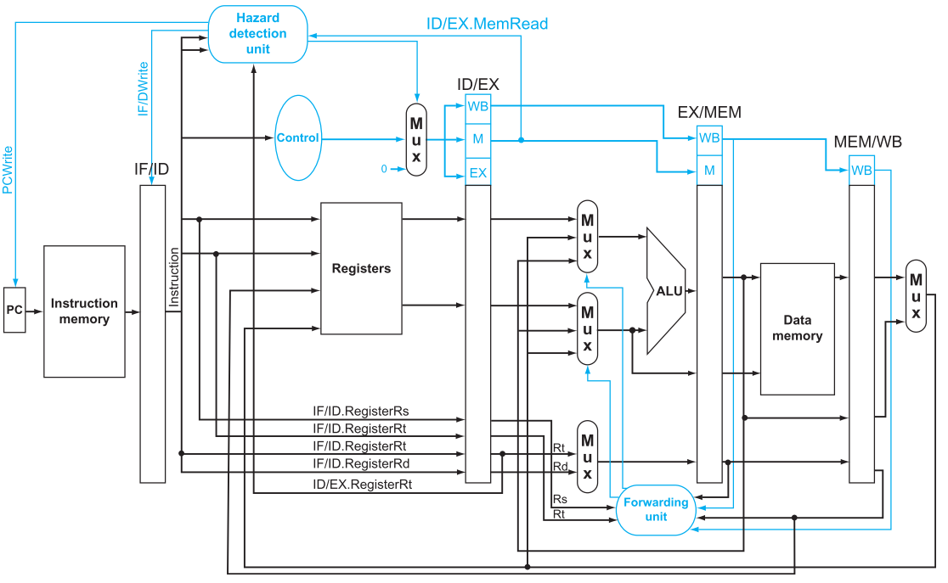
Hazard detection unit
To stall the pipeline, the instructions in ID stage should be stalled ➔ We can do it by continuing to read the same PC
To insert bubbles or nops, we set all the nine control signals to “0” ➔ no register or memories are written, which will create a “do nothing” instruction.

Slide 39
Data Hazards: Reordering
Given: Consider the following code segment in C:
a = b + e;
C = b + f;
Here is the generated MIPS code for this segment, assuming all variables are in memory and are addressable as offsets from $t0:
lw $t1, 0($t0)
lw $t2, 4($t0)
add $t3, $t1,$t2
sw $t3, 12($t0)
lw $t4, 8(t0)
add $t5, $t1, $t4
sw $t5, 16($t0)
Sought: Find the hazards in the following code segment and reorder the instructions to avoid any pipeline stalls. (The pipelined Datapath is equipped with forwarding/bypassing mechanism)

Slide 40



Data Hazards: reordering
1)lw $t1,0($t0)
$t1
$t2
2)lw $t2,4($t0)
3)add $t3,$t1,$t2
$t3
4)sw $t3,12($t0)
$t4
5)lw $t4,8(t0)
$t5
6)add $t5,$t1,$t4
7)sw $t5,16($t0)

Slide 41
Data Hazards: Reordering
1)lw $t1,0($t0)
$t1
$t2
2)lw $t2,4($t0)
3)lw $t4,8(t0)
$t4
$t3
4)add $t3,$t1,$t2
5)sw $t3,12($t0)
$t5
6)add $t5,$t1,$t4
No need for forwarding
Data is already available
7)sw $t5,16($t0)

Slide 42
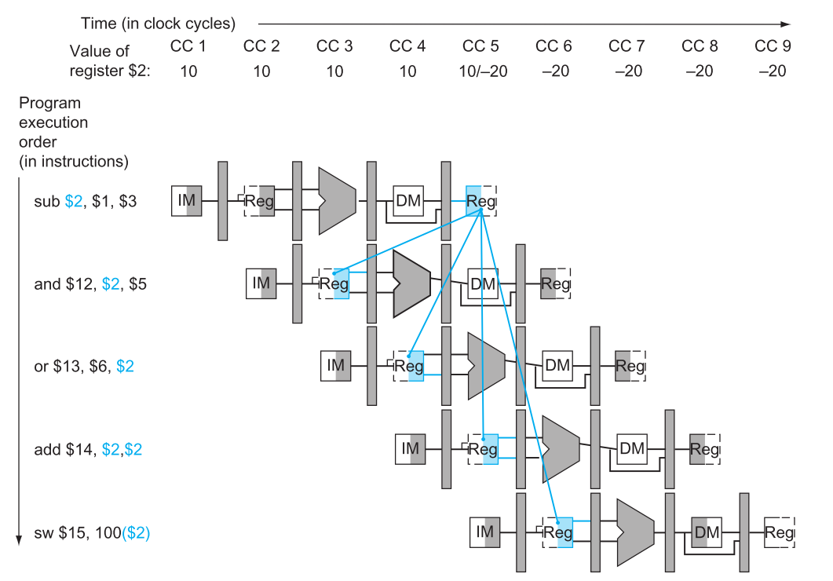
Data Hazards Detection
The value of $2 is changed during the cycle 5
These are the instructions that get the desired $2 value

Slide 43
Other types of data hazard
Write After Read (WAR) Hazard a.k.a “antidependence”
add $t1, $t0, $s1
and $t0, $s3, $s4
WAR Hazard is the result of the developer’s choice to choose the same register for two independent instructions, which can happen due to the limitation in the number available registers in MIPS processor, i.e. 32 registers.
Antidependence does not cause a hazard in simple MIPS pipeline, however, it could lead to a data hazard in out-of-order processors if the dependent instruction (and) is moved too early (before add in this example)
Write After Write (WAW) Hazard a.k.a “output dependence”
add $t0, $t1, $s1
and $t0, $s3, $s4
If the and instruction is moved before add instructions, the following instructions would work with the wrong data

Slide 44
Loop Unrolling and scheduling
Let’s see how the compiler can increase the amount of instruction level parallelism by unrolling loops.
Image the below code segment, in which x and s are double-precision floating point numbers:
for (i=999; i>=0; i=i-1)
x[i]=x[i]+s;
Assuming $s1 include the address of the element in the array with the highest address, $s2 is the address of the last element in the array, and $f2 contains the value s, the MIPS code for the above loop would be:
Loop: l.d $f0,0($s1) #$f0=array element
add.d $f4,$f0,$f2 #add s is $f2
s.d $f4,0($s1) #store result
addi $s1,$s1,-8 #decrement pointer
bne $s1,$s2,Loop #branch $s1!= $s1

Slide 45
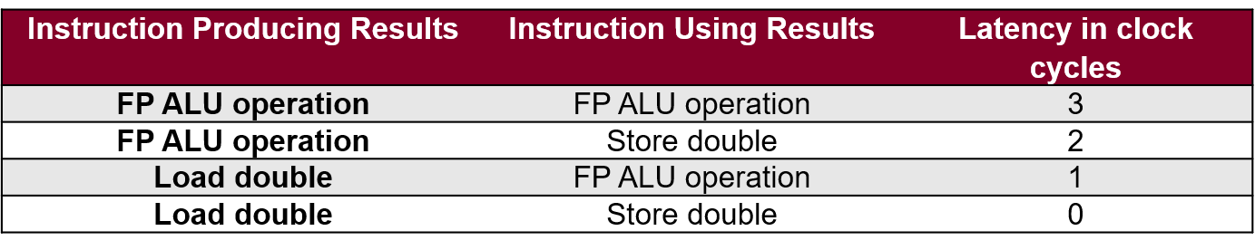
Loop Unrolling and scheduling
Given the below latencies for the dependent Floating-Point (FP) and Integer operations in a MIPS processor:
Without any reordering/scheduling the loop will execute as follows:
Loop: l.d $f0,0($s1)
add.d $f4,$f0,$f2
s.d $f4,0($s1)
addi $s1,$s1,-8
bne $s1,$s2,Loop
Loop: l.d $f0,0($s1)
<Stall>
add.d $f4,$f0,$f2
<Stall>
<Stall>
s.d $f4,0($s1)
addi $s1,$s1,-8
bne $s1,$s2,Loop
IPC= 5 inst/ 8 clk = 0.625

Slide 46
Loop Unrolling
Replicate loop body to expose more parallelism
Reduces loop-control overhead
Use different registers per replication
Called “register renaming”
Avoid loop-carried “anti-dependencies”
Increasing Instruction-Level Parallelism:
Avoiding Data Hazards

Slide 47
Loop Unrolling and scheduling
Image the below code segment, in which x and s are double-precision floating point numbers:
for (i=2; i>=0; i=i-1)
x[i]=x[i]+s;
Assuming $s1 include the address of the element in the array with the highest address, $s2 is the address of the last element in the array, and $f2 contains the value s, the MIPS code for the above loop would be:
l.d $f0,0($s1)
add.d $f4,$f0,$f2
s.d $f4,0($s1)
addi $s1,$s1,-8
l.d $f0,0($s1)
add.d $f4,$f0,$f2
s.d $f4,0($s1)
addi $s1,$s1,-8
l.d $f0,0($s1)
add.d $f4,$f0,$f2
s.d $f4,0($s1)
addi $s1,$s1,-8
l.d $f0,0($s1)
add.d $f4,$f0,$f2
s.d $f4,0($s1)
l.d $f0,-8($s1)
add.d $f4,$f0,$f2
s.d $f4,-8($s1)
l.d $f0,-16($s1)
add.d $f4,$f0,$f2
s.d $f4,-16($s1)
addi $s1,$s1,-24
Loop: l.d $f0,0($s1)
add.d $f4,$f0,$f2
s.d $f4,0($s1)
addi $s1,$s1,-8
bne $s1,$s2,Loop
Unrolling

Slide 48
Loop Unrolling and scheduling
What is the maximum IPC that can be achieved when unrolling the loop with a factor of 3?
Loop: l.d $f0,0($s1)
<Stall>
add.d $f4,$f0,$f2
<Stall>
<Stall>
s.d $f4,0($s1)
l.d $f0,-8($s1)
<Stall>
add.d $f4,$f0,$f2
<Stall>
<Stall>
s.d $f4,-8($s1)
l.d $f0,-16($s1)
<Stall>
add.d $f4,$f0,$f2
<Stall>
<Stall>
s.d $f4,-16($s1)
addi $s1,$s1,-24
bne $s1,$s2,Loop
Loop: l.d $f0,0($s1)
<Stall>
add.d $f4,$f0,$f2
<Stall>
<Stall>
s.d $f4,0($s1)
l.d $f6,-8($s1)
<Stall>
add.d $f8,$f6,$f2
<Stall>
<Stall>
s.d $f8,-8($s1)
l.d $f10,-16($s1)
<Stall>
add.d $f12,$f10,$f2
<Stall>
<Stall>
s.d $f12,-16($s1)
addi $s1,$s1,-24
bne $s1,$s2,Loop
Loop: l.d $f0,0($s1)
<Stall>
add.d $f4,$f0,$f2
<Stall>
<Stall>
s.d $f4,0($s1)
l.d $f0,-8($s1)
<Stall>
add.d $f4,$f0,$f2
<Stall>
<Stall>
s.d $f4,-8($s1)
l.d $f0,-16($s1)
<Stall>
add.d $f4,$f0,$f2
<Stall>
<Stall>
s.d $f4,-16($s1)
addi $s1,$s1,-24
bne $s1,$s2,Loop
Register renaming to remove antidependance

Slide 49
Loop Unrolling and scheduling
Now let’s do reordering to increase IPC:
Loop: l.d $f0,0($s1)
<Stall>
add.d $f4,$f0,$f2
<Stall>
<Stall>
s.d $f4,0($s1)
l.d $f6,-8($s1)
<Stall>
add.d $f8,$f6,$f2
<Stall>
<Stall>
s.d $f8,-8($s1)
l.d $f10,-16($s1)
<Stall>
add.d $f12,$f10,$f2
<Stall>
<Stall>
s.d $f12,-16($s1)
addi $s1,$s1,-24
bne $s1,$s2,Loop
Loop: l.d $f0,0($s1)
l.d $f6,-8($s1)
l.d $f10,-16($s1)
add.d $f4,$f0,$f2
add.d $f8,$f6,$f2
add.d $f12,$f10,$f2
s.d $f4,0($s1)
s.d $f8,-8($s1)
s.d $f12,-16($s1)
addi $s1,$s1,-24
bne $s1,$s2,Loop
Reordering/Scheduling
IPC= 11 inst/ 11 clk = 1

Slide 50
Control hazards
Control Hazards arise from the need to make a decision based on the results of one instruction while other are executing.
Branch Instruction: The pipeline cannot know what the next instruction should be!

Slide 51
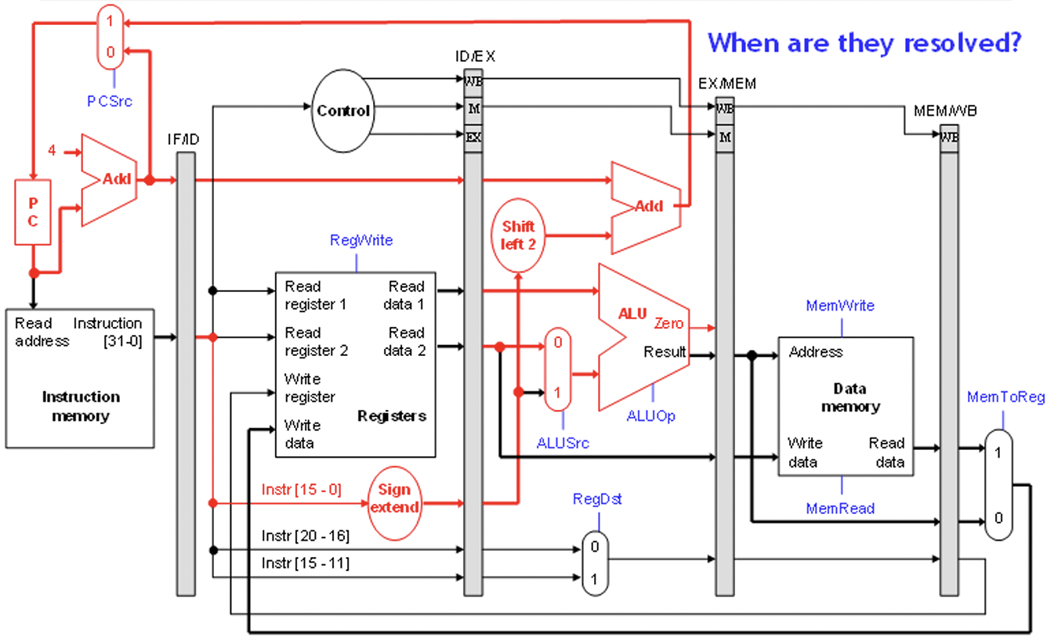
Branches in the original Pipelined Datapath

Slide 52
Branches
Most of the work for a branch computation is done in the EX stage.
The branch target address is computed.
The source registers are compared by the ALU, and the Zero flag is set
or cleared accordingly.
Thus, the branch decision cannot be made until the end of the EX stage.
But we need to know which instruction to fetch next, in order to keep the pipeline running!
This leads to what’s called a control hazard.
Clock cycle
1 2 3 4 5 6 7 8
beq $2, $3, Label
IM
Reg
DM
Reg
? ? ?
IM

Slide 53
Stalling is one Solution
Again, stalling is always one possible solution.
Clock cycle
4
1
2
3
5
6
7
8
beq $2, $3, Label
IM
Reg
DM
Reg
? ? ?
IM
IM
Reg
DM
Reg
Here we just stall until cycle 4, after we do make the branch decision.

Slide 54
Branch prediction
Branch Prediction: A method of resolving a branch hazard that assumes a given outcome for the branch and proceeds according to that assumption rather then waiting to ensure the actual outcome.
Possible Static Approaches:
always predict that branches will be untaken.
always predict that branches at the bottom of the loops will be taken, and branches at the top of the loop will be untaken.
Dynamic Branch Prediction: Keep history for each branch as taken or untaken, and then use the recent past behavior to predict the future.

Slide 55
Branch prediction
Another approach is to guess whether or not the branch is taken.
In terms of hardware, it’s easier to assume the branch is not taken.
This way we just increment the PC and continue execution, as for
normal instructions.
If we’re correct, then there is no problem and the pipeline keeps going at full speed.
Clock cycle
1 2 3 4 5 6 7
beq $2, $3, Label
IM
Reg
DM
Reg
next instruction 1
IM
Reg
DM
Reg
next instruction 2
IM
Reg
DM
Reg

Slide 56
Branch misprediction
If our guess is wrong, then we would have already started executing two instructions incorrectly. We’ll have to discard, or flush, those instructions and begin executing the right ones from the branch target address, Label.
Clock cycle
1 2 3 4 5 6 7 8
beq $2, $3, Label
IM
Reg
DM
Reg
next instruction 1
IM
Reg
flush
next instruction 2
IM
flush
Label: . . .
IM
Reg
DM
Reg

Slide 57
Implementing branches
We can actually decide the branch a little earlier, in ID instead of EX.
Our sample instruction set has only a BEQ.
We can add a small comparison circuit to the ID stage, after the
source registers are read.
Then we would only need to flush one instruction on a misprediction.
Clock cycle
1 2 3 4 5 6 7
beq $2, $3, Label
IM
Reg
DM
Reg
next instruction 1
IM
flush
Label: . . .
IM
Reg
DM
Reg

Slide 58
Implementing flushes
We must flush one instruction (in its IF stage) if the previous instruction is BEQ and its two source registers are equal.
We can flush an instruction from the IF stage by replacing it in the IF/ID pipeline register with a harmless nop instruction.
MIPS uses sll $0, $0, 0 as the nop instruction.
This happens to have a binary encoding of all 0s: 0000 .... 0000.
Flushing introduces a bubble into the pipeline, which represents the one- cycle delay in taking the branch.

Slide 59
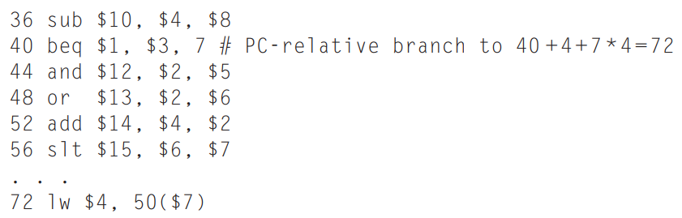
Branch prediction
Example: Show what happens when the branch is taken in the below instruction sequence, assuming that branch is predicted as “not taken”.

Slide 60
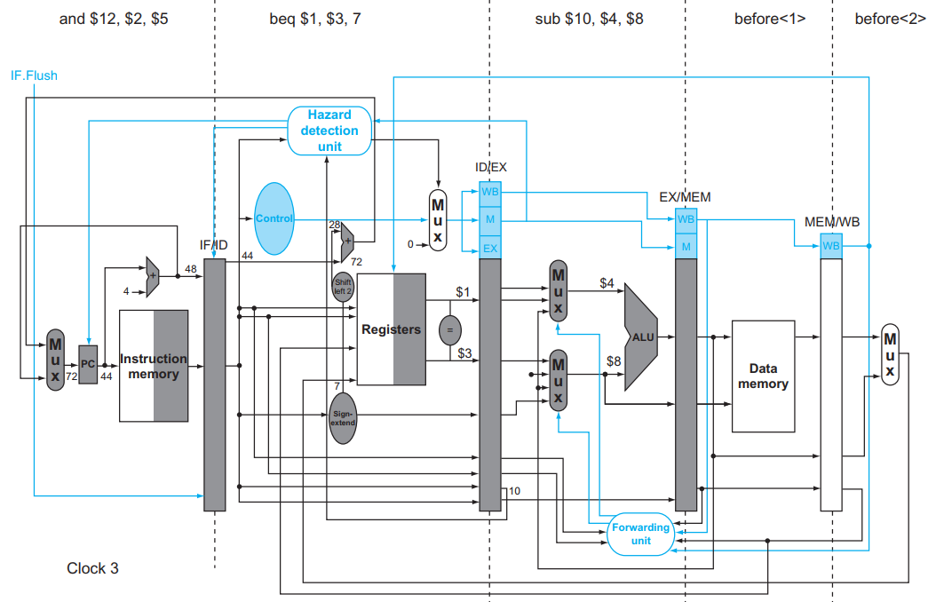
Branch prediction

Slide 61
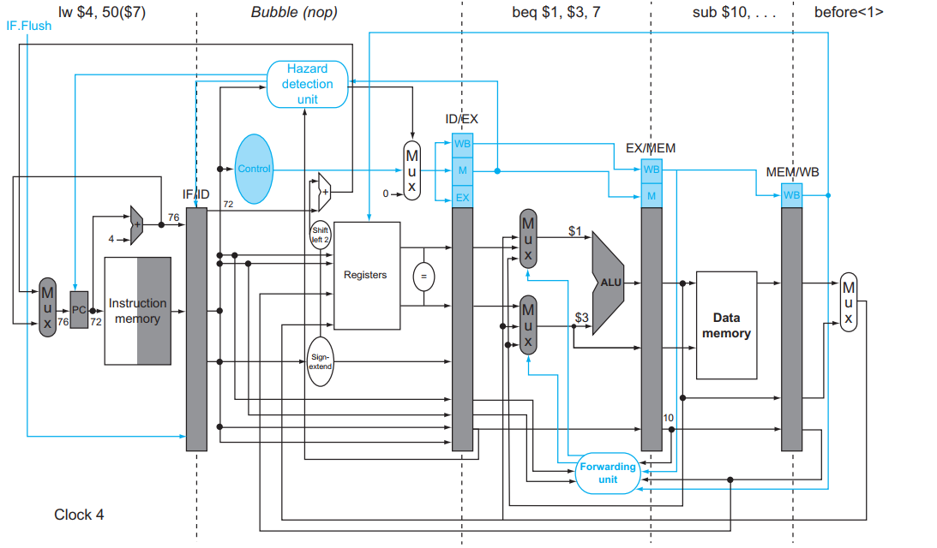
Branch prediction

Slide 62
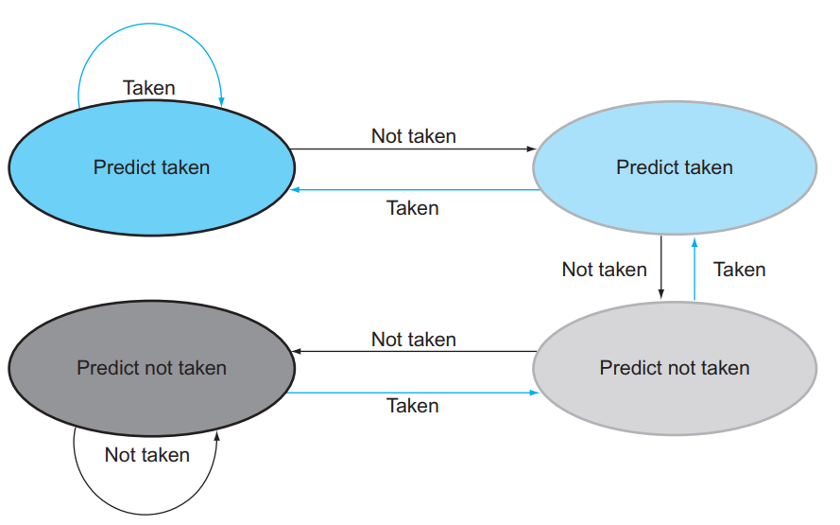
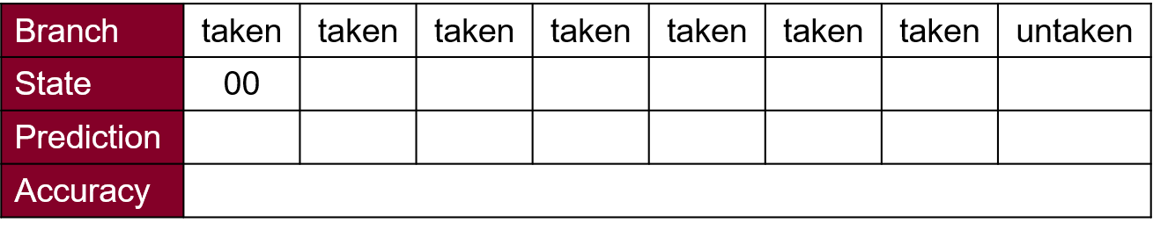
Dynamic Branch prediction
2-bit Dynamic Branch Prediction Scheme:
“00”
“01”
“11”
“10”
Given: Consider a loop that branches seven times in a row and then is not taken once. What is the prediction accuracy using the above 2-bit prediction scheme with the initial state of “00”?
00
00
00
00
00
00
00
➔ 01
True
True
True
True
True
True
True
False
7/8 = 87.5%

Slide 63

Dynamic Branch prediction
2-bit Dynamic Branch Prediction Scheme:
“00”
“01”
“11”
“10”
Given: Consider a loop that branches seven times in a row and then is not taken once. What is the prediction accuracy using the above 2-bit prediction scheme with the initial state of “10”?
01
00
00
00
00
00
00
➔ 01
False
True
True
True
True
True
True
False
6/8 = 75%

